Slide 1
Understanding Menstrual Hygiene
Practices • Products • Health • Myths Busted!
Dr. Manvi Singh
Department of Community Medicine
Rajshree Medical Research Institute
School Health Programme — Adolescent Education

Slide 2
What is Menstruation?
Menstruation is when the inner lining of the uterus (womb) is shed each month, causing some bleeding from the vagina.
💡 It is completely NORMAL — it is NOT a disease, NOT impurity, and NOT something to be ashamed of!
It is simply a sign that your body is growing up and is healthy!
9–16 yrs
21–40 days
3–7 days
First Period
Cycle Length
Bleeding Days

Slide 3
📅 Your Monthly Cycle – 3 Phases
🔴 Days 1–7: Period
The uterus sheds its lining. Bleeding happens. You may feel some cramps — that's normal!
🟡 Days 8–14: Recovery
Bleeding stops. The uterus builds a new lining. The ovary gets ready to release an egg.
🟣 Days 15–28: Waiting
If the egg is not fertilised, hormone levels drop. Then the whole cycle starts again!

Slide 4
🗓️ Irregular Periods — Don't Panic!
🌟 Very Common in the First 1–2 Years
When you first get your period, it may not come every month on the same date.
Cycles can vary from 3 to 6 weeks. This is completely NORMAL — your body is still adjusting!
Usually becomes regular within 2–3 years. No need to worry!
✅ You're FINE if:
⚠️ See a Doctor if:
• Periods skip a month occasionally
• Cycles are 21–40 days apart
• Bleeding lasts 3–7 days
• Slight variation month to month
• No period for 3+ months in a row
• Cycles shorter than 21 days
• Very heavy pain every cycle
• Periods that last more than 8 days

Slide 5
💊 Cramps & Pain — What's Normal?
Mild cramps are totally normal! They are caused by natural hormones in your body called prostaglandins that help the uterus shed its lining. Most cramps last 1–3 days.
💡 Natural Remedies That Help:
🌡️ Warm compress on your lower tummy
🚶 Light walking or gentle stretching
🫖 Ginger tea or warm water
😴 Rest and take it easy
🎵 Listen to music, relax!
🍫 Dark chocolate (a little!) can help
⚠️ See a doctor if pain is so bad it stops you from going to school!

Slide 6
🔴 Heavy Bleeding & PMS Symptoms
Heavy Bleeding — When to Worry
PMS — What is it?
Some months feel heavier — that's okay!
See a doctor if:
❌ Bleeding lasts MORE than 8 days
❌ You soak a full pad in under 1 hour
❌ You see large blood clots regularly
These could be signs that need a doctor's attention — not something to ignore!
PMS = Pre-Menstrual Syndrome
Symptoms that appear a few days BEFORE your period:
😔 Mood changes / feeling emotional
🤕 Headaches
😴 Feeling tired or low energy
🫃 Bloating (tummy feels puffed up)
🤱 Breast tenderness
✅ Good news: These usually go away once bleeding starts!

Slide 7
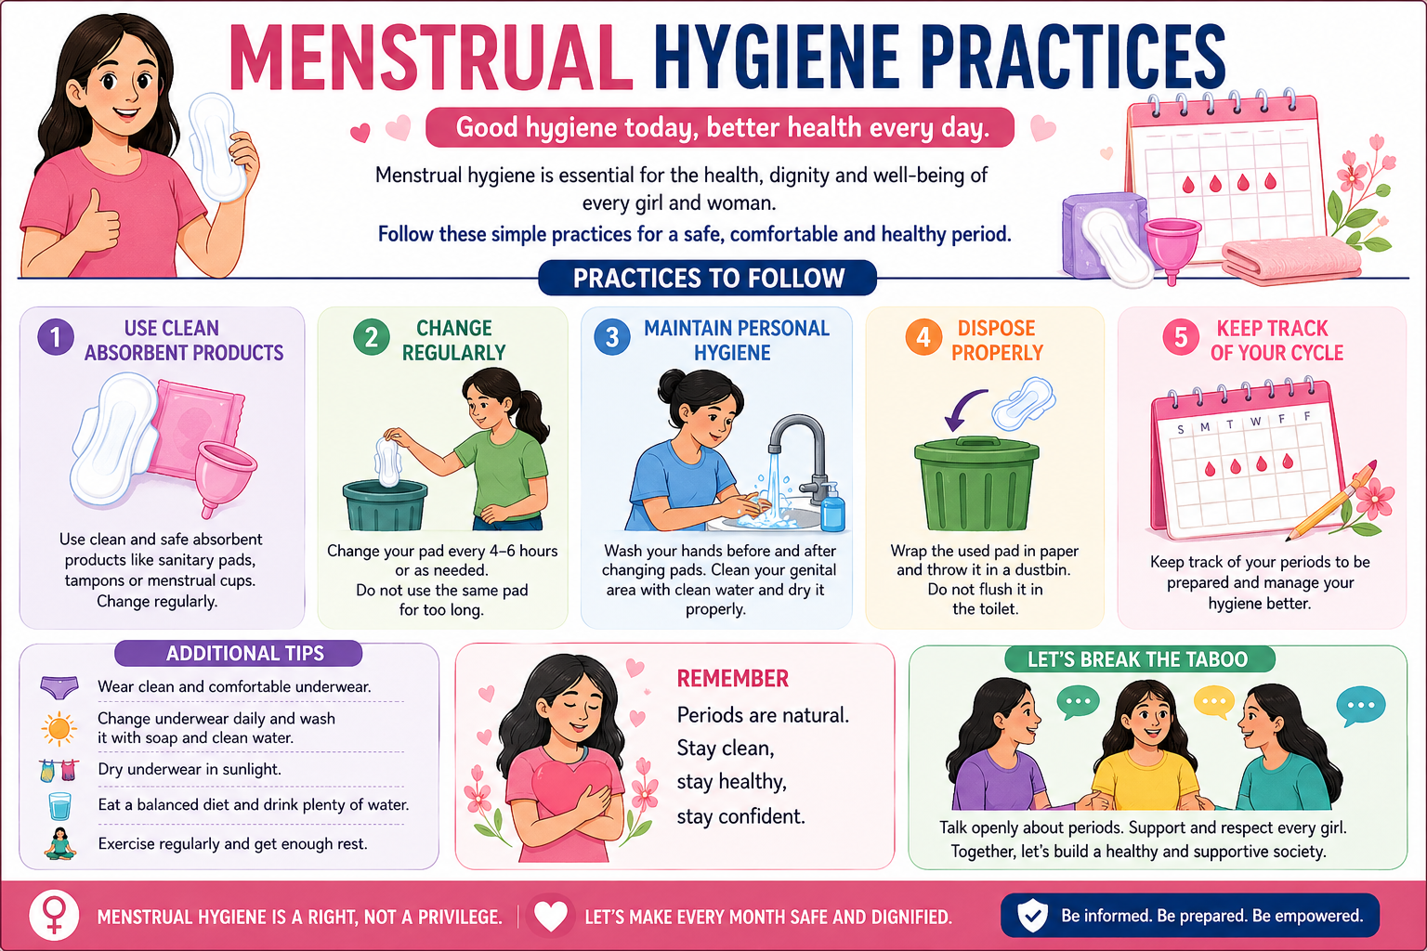

Slide 8
🧼 Hygiene Rule #1 — Change Your Product Regularly
⏰ Change every 4–6 hours — or sooner if the pad feels full!
NEVER wear a pad for more than 8 hours — bacteria can multiply and cause infections like rashes and bad smell.
1
Change Every 4–5 Hours
2
Carry a Spare Pad
3
Use the School Toilet
Make it a habit to change your pad every 4–5 hours during the day — even if it does not feel full!
Always keep an extra pad in your school bag or pencil case — just in case!
Your school has facilities for this. Use them without hesitation — your health matters!

Slide 9
🙌 Hygiene Rule #2 — Always Wash Your Hands!
Wash hands with soap and clean water BEFORE and AFTER changing any menstrual product. This stops germs from getting into your body.
How to wash hands properly:
1
Wet your hands with clean water
2
Apply soap — any soap is fine!
3
Scrub for at least 20 seconds (sing 'Happy Birthday' twice!)
4
Rinse thoroughly under running water
5
Dry with a clean cloth or air-dry
💡 No soap? Use hand sanitizer if available!

Slide 10
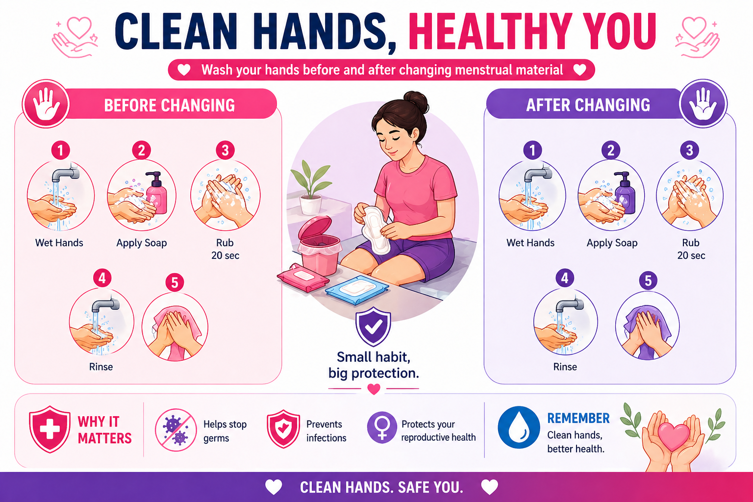

Slide 11
🚿 Hygiene Rule #3 — Keep Your Body Clean
Washing the Outside
INSIDE the Vagina
✅ Wash the OUTER area (vulva) gently with clean water
✅ Always wipe/wash from FRONT to BACK
✅ Once or twice a day is enough
❌ Do NOT put soap, water or any product INSIDE the vagina
❌ Do NOT use scented sprays or wipes inside
✅ The vagina CLEANS ITSELF naturally — trust it!
🛁 MYTH vs FACT: Bathing During Periods
MYTH: Bathing during periods makes cramps worse or slows your flow.
FACT: 100% FALSE! Bathing is ESSENTIAL during your period. It keeps you comfortable, fresh, and infection-free. Bathe every single day! 🚿

Slide 12
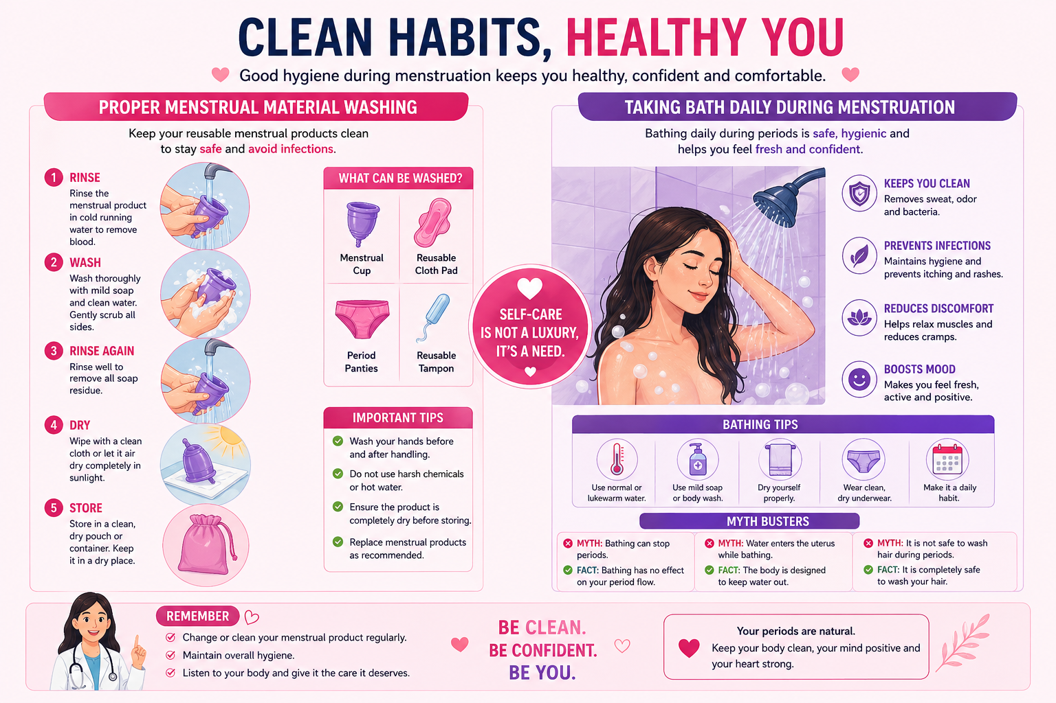

Slide 13
📋 Good Daily Habits During Your Period
4 👗 Change Soiled Underwear ASAP
5 📦 Store Products Properly
If your underwear gets stained or wet, change it as soon as you can. Bacteria grow fast in damp cloth!
Keep your pads in a clean, dry place. Check expiry dates! A damp pad can carry bacteria.
6 🏃‍♀️ Stay Active — Go to School!
7 📱 Track Your Cycle
Menstruation is NOT a reason to skip school or sports. Light movement like walking actually REDUCES cramps!
Mark your period start date on a calendar or period-tracking app. This helps you prepare and stay stress-free.

Slide 14
🩹 Sanitary Pads — The Most Popular Choice
With Wings 🦋
Without Wings
Overnight / Maxi Pad 🌙
Has a sticky strip on the back and flaps that fold under your underwear. Wings prevent leaks! Most popular for school.
A simpler pad with just a sticky back. Good for lighter flow days. Easy to use for beginners!
Longer and more absorbent. Use at night or on heavy flow days. Great for sleeping without worrying!
Why Pads are Great:
✓ Easy to use ✓ No washing needed ✓ Available in schools & pharmacies ✓ Don't restrict movement or sports ✓ Change every 4–6 hrs

Slide 15
📖 How to Use a Sanitary Pad (Step by Step)
1
Wash your hands with soap and water first.
2
Unwrap the pad and peel off the backing paper from the sticky part.
3
Place the pad sticky-side DOWN in the middle of your underwear.
4
If it has wings, fold them around the sides of your underwear and press to stick.
5
Pull up your underwear and make sure it feels comfortable and centered.
6
Wash hands again! You're done. Change after 4–6 hours.
🌟 Tip: Practise at home so you feel confident at school!

Slide 16
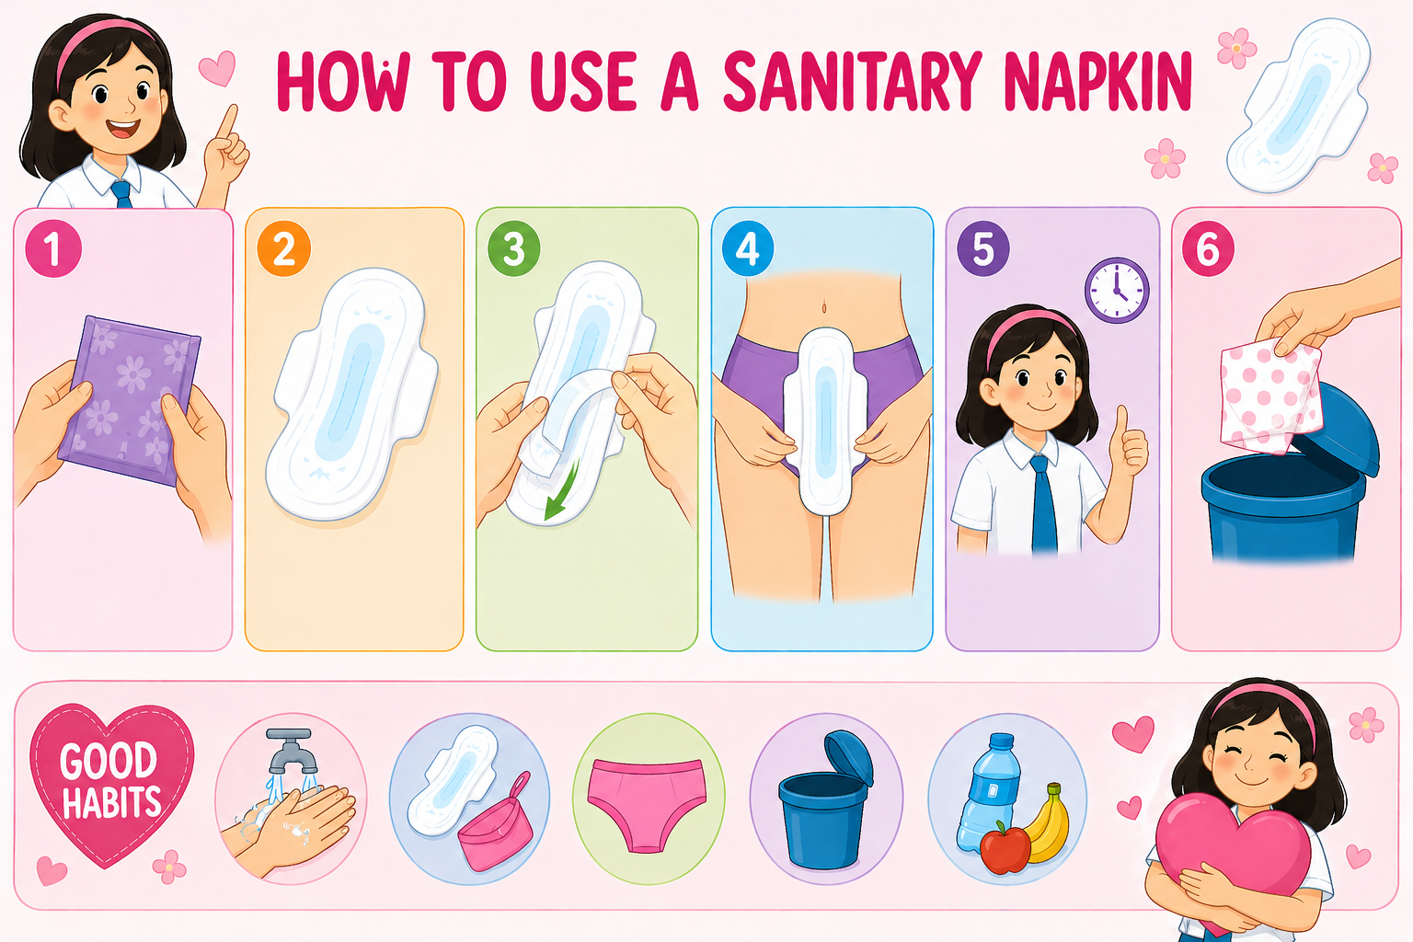

Slide 17
🌿 Menstrual Cups — The Eco-Friendly Option!
A menstrual cup is a small, flexible silicone cup that is inserted into the vagina. It COLLECTS the blood (doesn't absorb it) and can be reused for 5–10 years!
How to Use:
1
Wash hands + wash the cup with soap and water.
2
Fold the cup into a C-shape or punch-down shape and insert it gently.
3
Remove, empty, rinse and boil with water, and reinsert every 8–12 hours.
4
At the END of your period, boil the cup in water for 5 minutes to sterilise it.
5
Store in the cloth bag that comes with it — ready for next month!
🌟 Benefits: Eco-friendly • Saves money long-term • Holds more than a pad • Safe overnight • Zero waste!

Slide 18
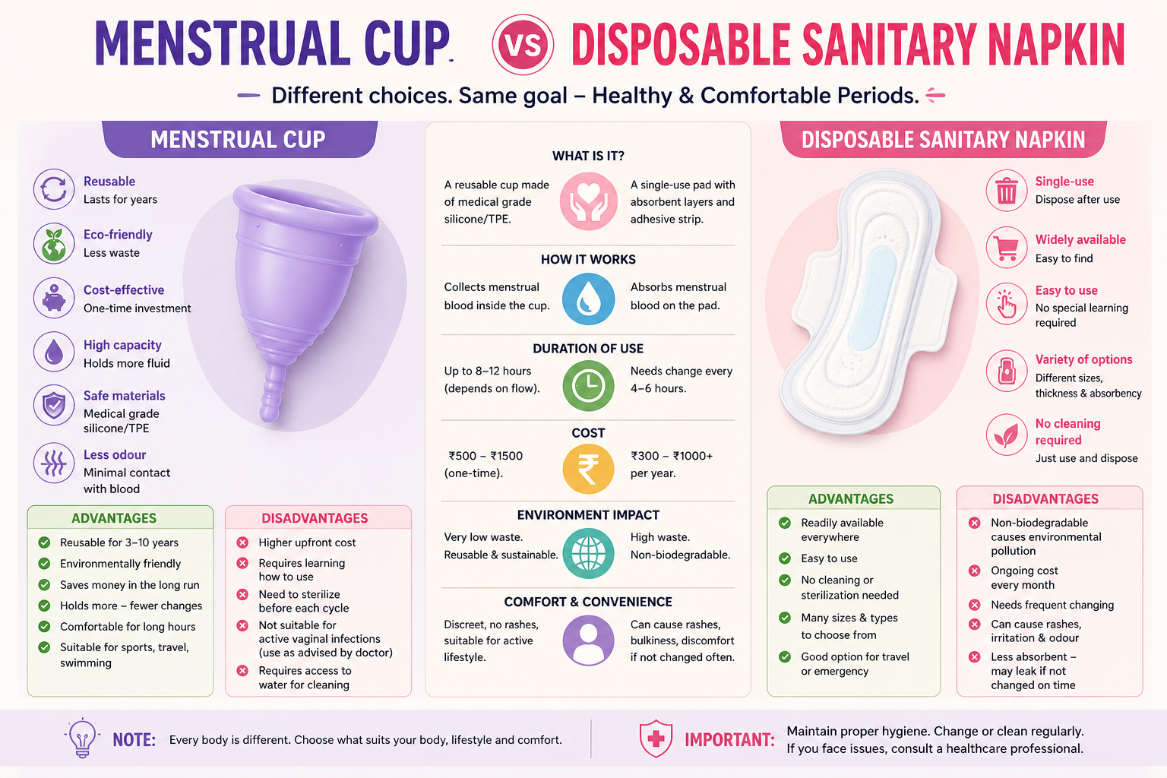

Slide 19
📊 Choosing the Right Product
Product | Cost | Eco-Friendly? | Best For | Change Every
🩹 Sanitary Pad | Low–Medium | ❌ Single use | Beginners, everyday use | 4–6 hours
🟢 Menstrual Cup | High (one-time) | ✅ Reusable 10 yrs! | Regular users, eco lovers | 8–12 hours
⚠️ Important: Unclean cloth rags are NOT safe! They carry infection risk from bacteria and fungi. Always choose a proper menstrual product.

Slide 20
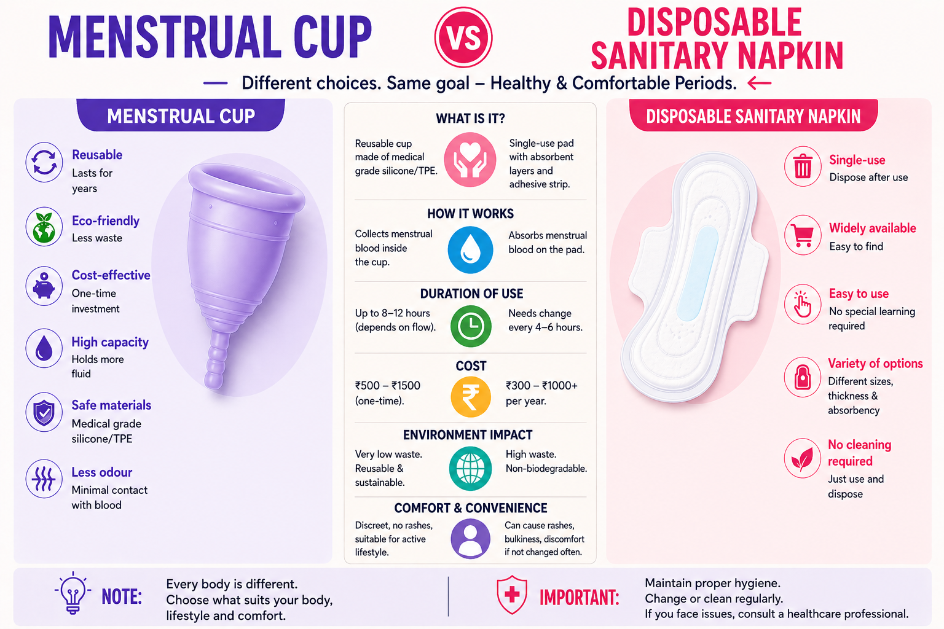

Slide 21
⚠️ Why Cloth Rags Are Risky
Risks of Cloth Rags
✅ Better Alternatives
❌ Bacterial infections — can cause UTI (urinary tract infection) or vaginal infection
🩹 Sanitary Pads
Free or low-cost from schools, ASHA workers, Anganwadi centres, & government health schemes.
❌ Fungi and mould grow in damp cloth if not dried properly
🌿 Biodegradable Pads
❌ Cloth dried indoors or in the dark stays damp — bacteria survive and multiply
Made from plant fibres, gentler on skin. Available in health stores & online.
❌ Rough fibres cause skin rashes and irritation
🟢 Menstrual Cups
❌ Absorbs less blood — higher chance of leakage and embarrassment
One-time cost, reusable for 10 years. Zero waste option.

Slide 22
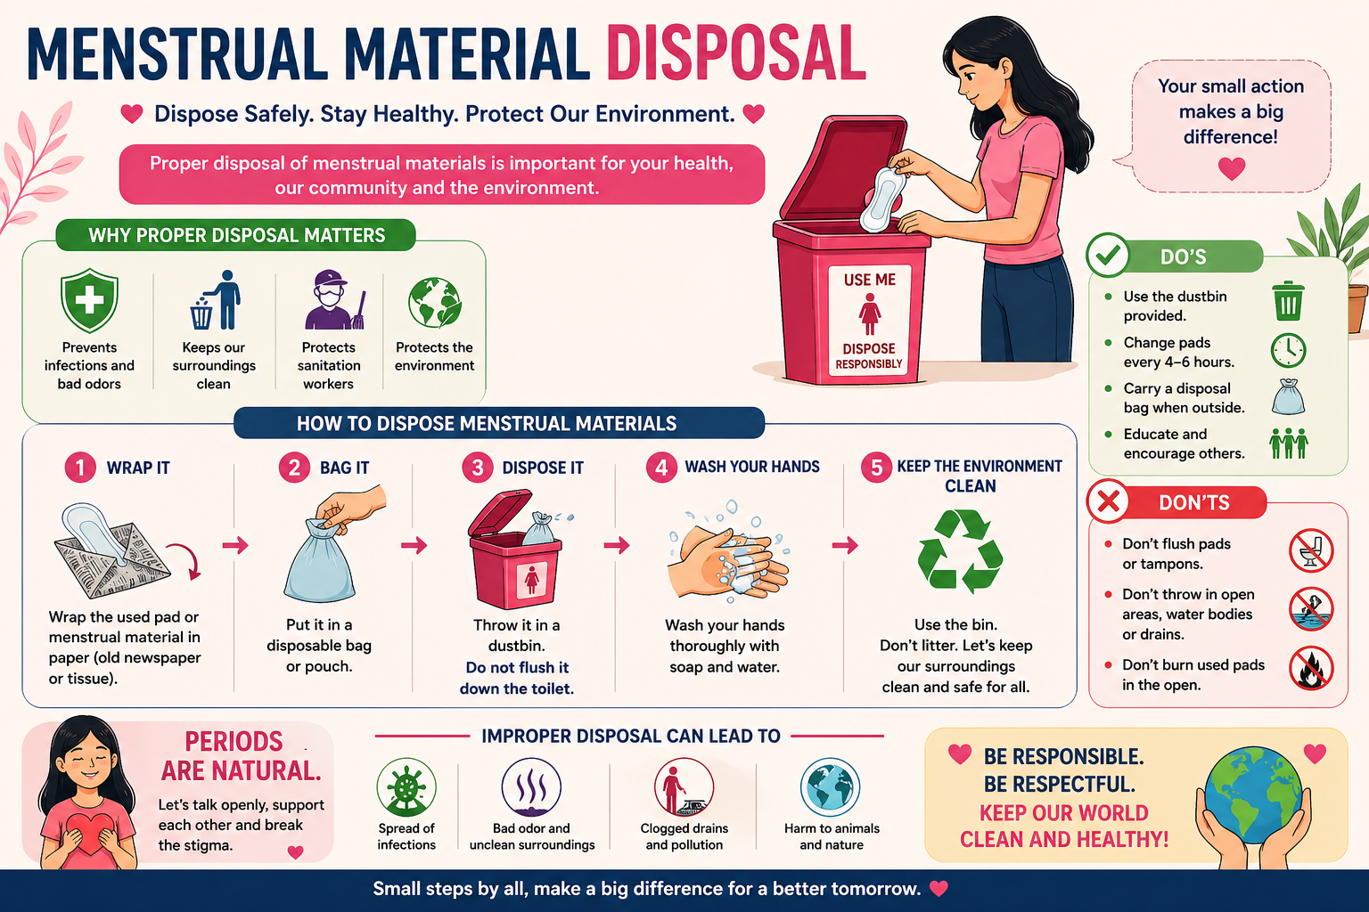

Slide 23
♻️ How to Dispose of Menstrual Products Safely
🏫 At School
🏠 At Home
Step 1: Wrap the used pad tightly in the wrapper it came in, or in a piece of newspaper or tissue.
Step 2: Place it inside the closed dustbin or sanitary bin inside the girls' toilet — NOT on the floor or in the open drain.
Step 3: Wash your hands with soap after disposal.
✅ Always keep the bin lid closed.
✅ Never flush a pad down the toilet — it will block the drain!
Step 1: Wrap the used pad in old newspaper or a small plastic bag. Seal it so there is no leakage or smell.
Step 2: Put it in the DRY WASTE bin at home — keep it separate from wet kitchen waste like food scraps.
Step 3: When the waste collector comes, let them know it is dry waste — properly wrapped pads can be safely handled.
❌ Never burn pads at home — burning releases toxic fumes.
❌ NEVER throw used pads in open fields, drains, rivers, or water bodies — this spreads disease and harms the environment!

Slide 24
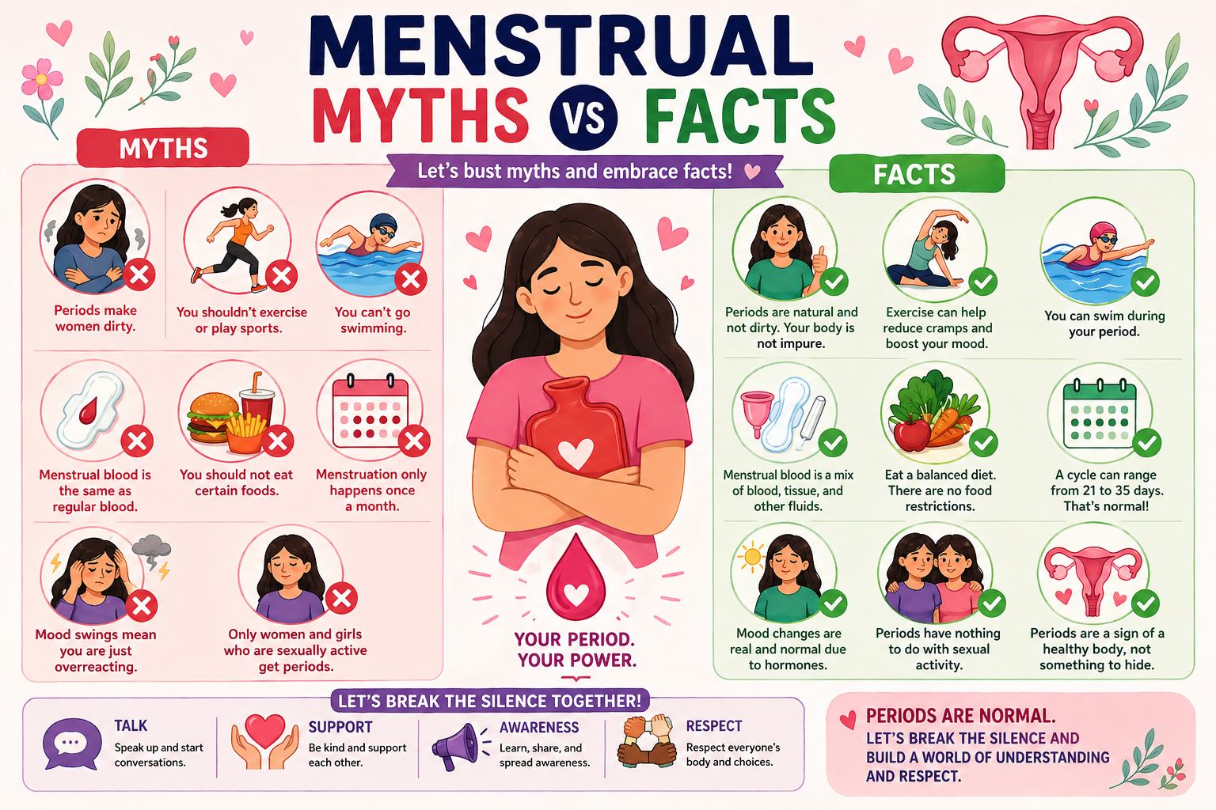

Slide 25
🔍 Myths vs Facts
MYTH
❌ MYTH: Girls should stay home and skip school during their periods.
✅ FACT: Menstruation is NOT a reason to miss school or activities. Girls can do EVERYTHING normally. Keep attending school!
MYTH
❌ MYTH: A girl's body becomes impure or dirty during menstruation.
✅ FACT: Completely FALSE. Menstruation is a healthy, natural body process. There is ZERO impurity. It shows your body is healthy!
MYTH
❌ MYTH: You shouldn't bathe or wash your hair during your period.
✅ FACT: Bathing is ESSENTIAL every day during your period. It does not affect your flow or cramps — this is a total myth!

Slide 26
🔍 Myths vs Facts
MYTH
❌ MYTH: Touching food or plants during your period harms them.
✅ FACT: Menstruating girls do NOT harm food, plants, or religious activities. There is ZERO scientific basis for this belief.
MYTH
❌ MYTH: You should not exercise or play sports during your period.
✅ FACT: Exercise is absolutely FINE during your period! In fact, light activity like walking or stretching helps reduce cramps and improves your mood.
MYTH
❌ MYTH: Period blood is dirty or infected blood.
✅ FACT: Menstrual blood is the normal lining of the uterus mixed with blood. It is normal body tissue — not dirty or infected at all!

Slide 27
🏛️ Government Programmes
📋 RKSK — Rashtriya Kishor Swasthya Karyakram
A national programme for adolescent health (ages 10-19). RKSK provides free sanitary pads to girls through schools, ASHA workers, and health centres across India. It also covers nutrition, mental health, and reproductive awareness, supporting girls holistically.
🏫 MHM in Schools — Swachh Bharat Mission
Under the Swachh Bharat Mission, the government mandates separate, clean toilets for girls in all schools. Schools must have incinerators or sealed disposal bins for used pads. Menstrual hygiene education is integrated into the school curriculum nationwide.

Slide 28
🏛️ Government Programmes
💚 Suvidha — Affordable Pad Scheme
The Government of India launched Suvidha sanitary pads under the Pradhan Mantri Bhartiya Janaushadhi Pariyojana. These pads are sold at just Rs.1 per pad at Jan Aushadhi Kendras (government-run generic medicine stores), making safe menstrual hygiene affordable for every girl and woman.
📊 SABLA & POSHAN Abhiyaan
SABLA (Rajiv Gandhi Scheme) empowers adolescent girls with health, nutrition, and life-skills education including menstrual hygiene. POSHAN Abhiyaan promotes overall wellbeing of women and girls. Both schemes distribute materials and conduct awareness sessions via Anganwadi centres.

Slide 29
💬 It's Okay to Talk About Periods!
Periods are nothing to be embarrassed about! In fact, talking openly with trusted people helps you get support, answers, and the products you need. Here's who you can talk to:
👩‍👧 Your Mother or Grandmother
👩‍🏫 Your Female Teacher
They have experience and can share how they managed. Don't feel shy — they went through the same thing!
Teachers can help you access pads, excuse you from class if needed, and give good advice.
🏥 School Health Worker / Nurse
👭 A Trusted Friend
They are trained to help with exactly these questions. Everything stays private!
Talking to a friend the same age can be very comforting — you may be going through the same experiences.

Slide 30
🏥 When Should You See a Doctor?
Most period symptoms are NORMAL. But some signs mean your body needs a doctor's help. Always tell a trusted adult if you notice any of these:
🔴 Bleeding that lasts MORE than 8 days
🔴 You need to change your pad every hour or less
🔴 You see very large blood clots regularly
🔴 Severe cramps that stop you from going to school
🔴 No period at all for more than 3 months in a row
🔴 Periods that are always very irregular even after 2 years
🔴 Unusual smells, itching, or discharge
🔴 Feeling very dizzy, weak, or fainting during your period
💚 Visiting a doctor is BRAVE and RESPONSIBLE — not something to be embarrassed about. Doctors are here to help!

Slide 31
🌼 Taking Good Care of Yourself
🛁 Rest When You Need To
It's okay to rest if you feel tired or have cramps. Listen to your body — resting is not laziness! Your health always comes first.
🥗 Eat Nourishing Food
Eat iron-rich foods like leafy greens, lentils, and bananas. Drink plenty of water. Avoid too much junk food or sugary drinks during your period.
🧘‍♀️ Gentle Movement
Light stretching or a short walk can ease cramps and improve your mood. No need for intense exercise — gentle movement is best!

Slide 32
🌼 Taking Good Care of Yourself
💬 Talk About How You Feel
If you feel low, anxious, or upset during your period, talk to someone you trust. Your feelings are completely valid! You don't have to cope alone.
🌙 Sleep Well
Try to sleep 8-9 hours each night. Use a good pad at night and change it first thing in the morning to stay comfortable and avoid infections.
📖 Know Your Body
Track your periods, notice your patterns, and remember — every girl's experience is a little different. That's completely normal! A period tracking diary or app can help.

Slide 33
💪 Breaking the Stigma — Together!
Period stigma means treating menstruation as something shameful or secretive. This harms girls and prevents them from getting the help they need. WE can all help change this!
👧 Girls can:
👨‍👩‍👧 Families can:
🏫 Schools can:
Talk to a trusted adult when you need help. Don't suffer in silence. Your health matters!
Talk about periods openly at home. Make sure girls have access to proper products and support.
Provide pads, clean toilets, and safe disposal facilities. Teach menstrual health to everyone!

Slide 34
📝 Quick Recap — Remember These 7 Things!
1
Menstruation is NORMAL — not impure, not a disease, and not a barrier to any activity.
2
Use sanitary pads or menstrual cups. Change every 4–8 hours. Avoid unclean cloth rags.
3
Wash your hands before and after changing products. Wash the outer private area gently with water.
4
Bathe EVERY DAY during your period. Dispose safely — wrap & bin at school, separate dry waste at home.
5
Track your cycle. Carry a spare pad. Stay active and go to school!
6
See a doctor if bleeding is very heavy, very painful, or lasts more than 8 days.
7
Talk to a trusted adult when you need help. You are never alone in this journey! 💕

Slide 35
🌸
You Are Informed.
You Are Empowered.
You Are in Control of Your Health!
✨ Never be ashamed of your body
✨ Ask for help whenever you need it
✨ Support your friends and classmates

